Slide 1


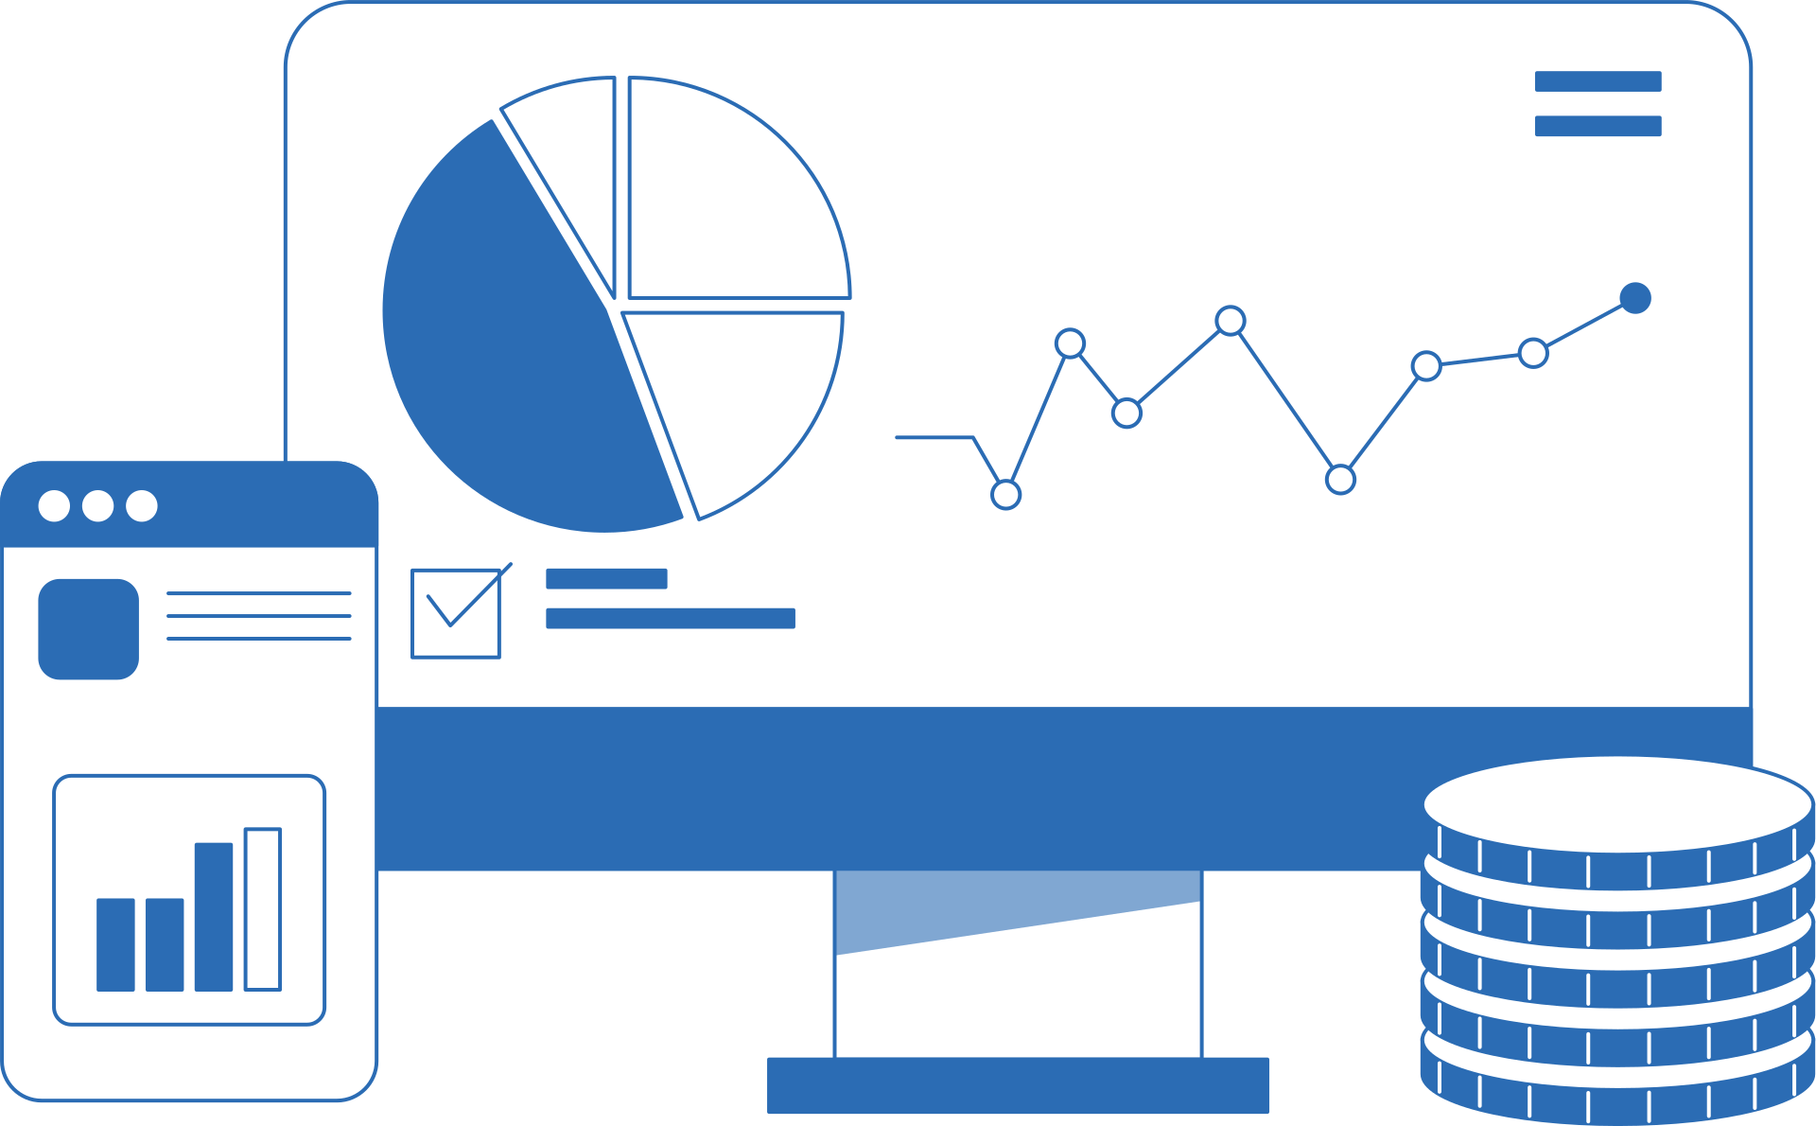

Team 2
Supply
chain
Insights

Slide 2
Team Members
AlaaHassan
Mariam Alaa
Sara Tawfik
Kyrillos Nassar
Marwan Ayman

Slide 3

Project
Overview
This project presents a supply chain dashboard designed to provide a comprehensive overview of key operational activities and performance indicators across the supply chain process. The dashboard integrates and visualizes data related to inventory management, order fulfillment, transportation, and overall logistics performance. By organizing this information into clear and interactive visuals, it allows users to quickly understand how different parts of the supply chain are performing.
The dashboard aims to support better monitoring and analysis of supply chain operations by highlighting important trends, patterns, and performance metrics. Through these insights, users can identify potential inefficiencies, evaluate operational performance, and gain a deeper understanding of supply chain dynamics. Overall, the project demonstrates how data visualization can transform complex operational data into meaningful insights that help support more informed and strategic decision-making.

Slide 4
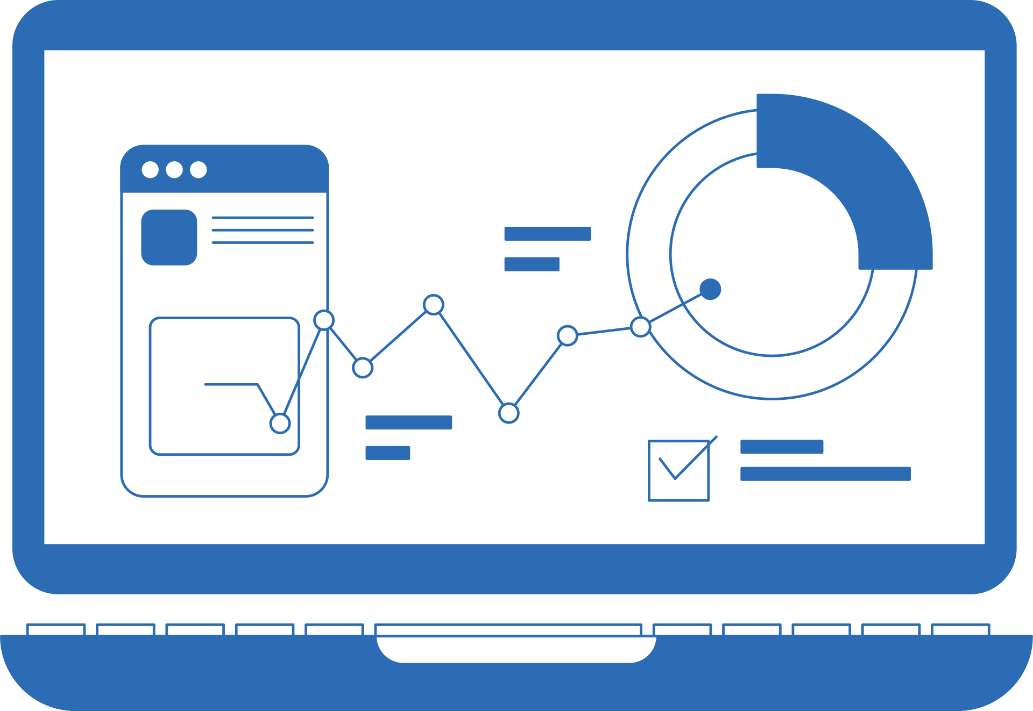
Analysis
Data QC
Steps
Data Cleaning
Data Modeling
DAX
Report
Dashboard

Slide 5

Data
Source
This study is based on data obtained from the Digital Egypt Pioneers Initiative (DEPI) platform, where the dataset was provided for educational and training purposes. The data is well-structured and reliable, making it suitable for analysis and interpretation. In addition, Data Quality Control (QC) procedures were applied to ensure the accuracy, consistency, and completeness of the data before conducting the analysis.

Slide 6
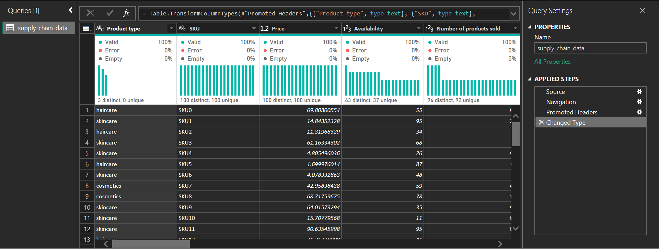
Data
Cleaning
Before

Slide 7
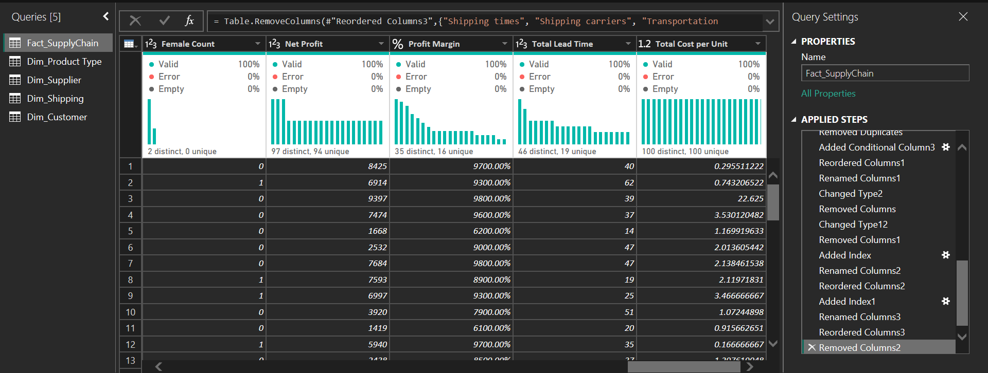
Data
Cleaning
After

Slide 8
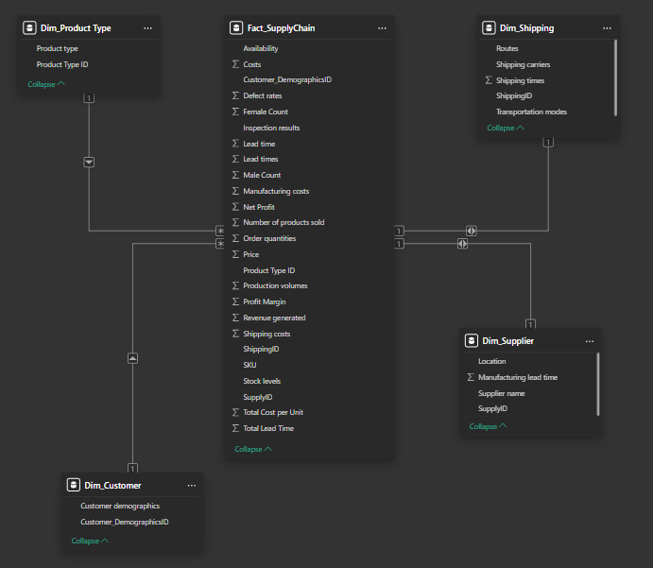
Data
Modeling

